Slide 1
Overview of the WEST ICRH Results for C5
February 2021
J.Hillairet, L.Colas and the WEST IC Team: J.M.Bernard, F.Durand, N.Faure, P.Garibaldi, G.Lombard, P.Mollard & D.Mouyon
With the (remote) participations of W.Helou (IO), E.Lerche (ERM), R.Ragona (ERM) and G.Urbanzcyck (ASIPP)

Slide 2
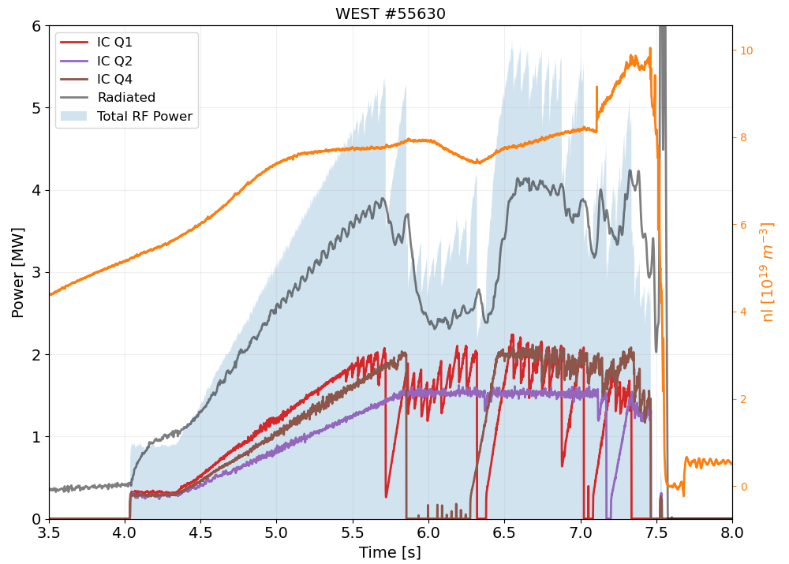
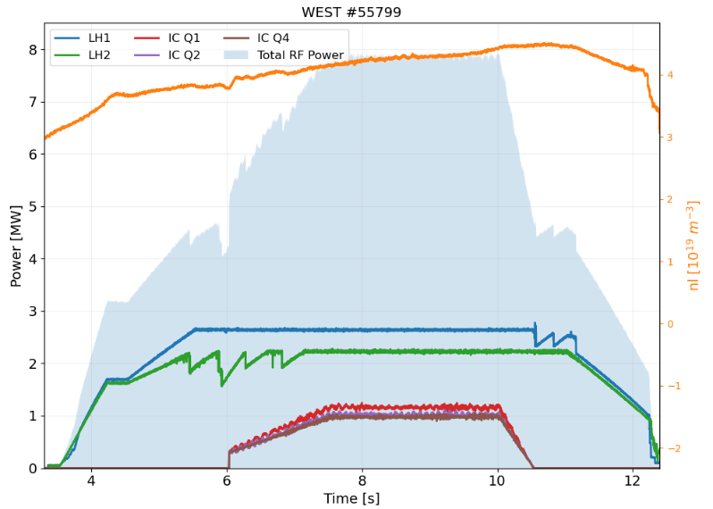
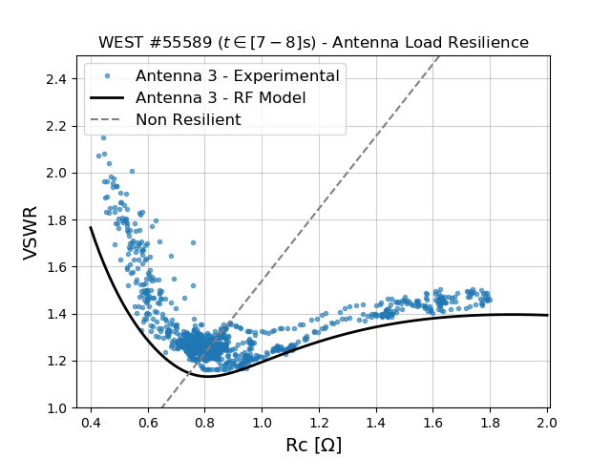
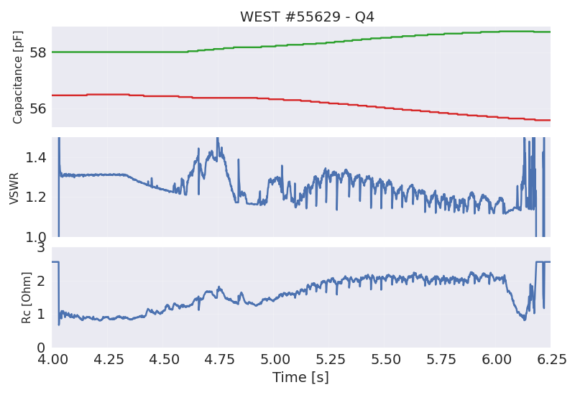
Where we were at the end of the WEST C4 campaign (1/2)
The WEST ICRH antennas successfully validated
All three antennas operational simultaneously on plasma
3 MW/few seconds, 5 MW/500ms, and close to 6 MW peak.
Up to 8 MW total RF power (IC + LH) (close to 9 MW peak)
Load resilience confirmed on all antennas
Automatic matching demonstrated
C1 (top)
C2 (bot)

Slide 3
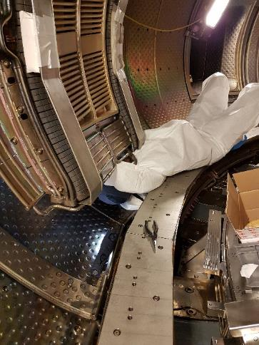
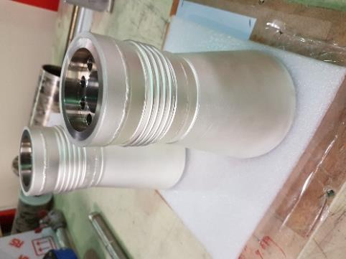
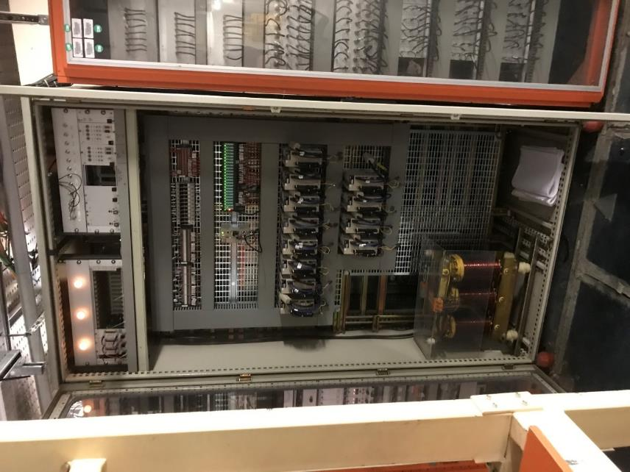
Where we were at the end of the WEST C4 campaign (2/2)
Work performed during S4 shutdown
1 Voltage probe out of order on Q1 → Q1 removed from WEST, cables repaired and hardened → In-vessel fixes for Q4 (not Q2)
Modifications of all vacuum feedthrough (to allow long pulses)
Toroidal phase control with mixed results depending of the antenna → Phase Measurements and Control Loop modified (more in next slides)
Few capacitors couldn’t move due to out of order (obsolete) servopacks → Motors and motorization control fully refurbished
Emptying Q4
In-vessel RF cable fix
Vacuum feedthrough Internal conductor
3 controllers →1 controller
12 new motors
12 new servopacks

Slide 4
WEST C5 Main Results

Slide 5
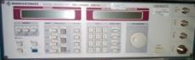
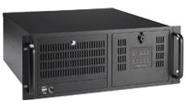
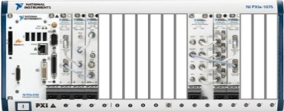
New Toroidal Phase Control (1/2)
Antenna phase measurements and control simplified
Left side (see from behind the antenna) is the reference
Right side is frequency-modulated to shift the phase w.r.t. left side
A FPGA-based PID controls toroidal phase between (top) straps from SL phase request
Response time to change request is ~50 µs and very robust
Capa 1
V₁
Left side HP Amplifier
RF source
DFCI
Phase request (from Session Leader)
Phase reference
Fast optic transmitter
V₂
Capa 2
Master Oscillator 10MHz reference
PXIe DAQ unit
V₃-V₁
Phase measurement
system
Frequency modulation
Frequency modulation
PID in 3 FPGA Cards
(1/antenna)
Capa 3
V₃
RF source
Right side HP Amplifier
V₄
Capa 4

Slide 6
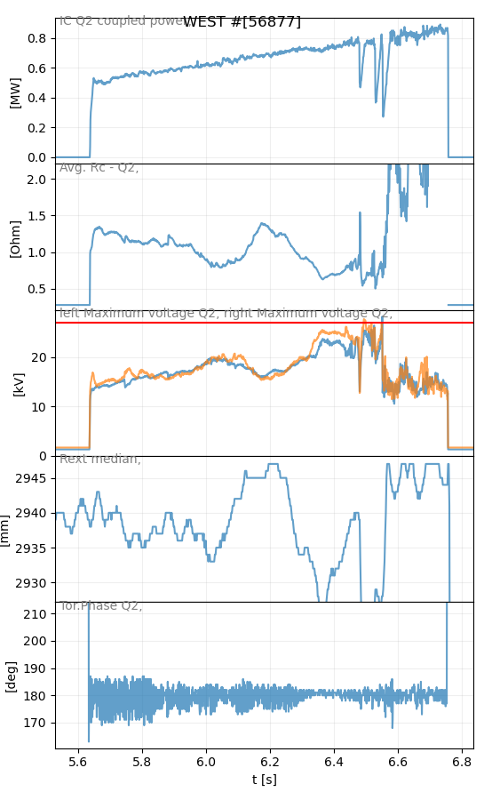
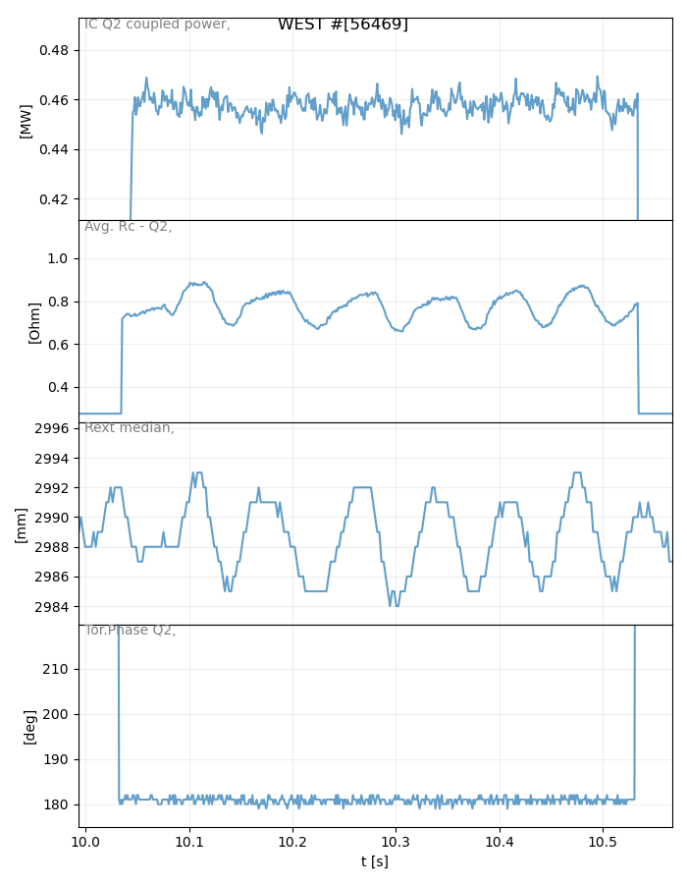
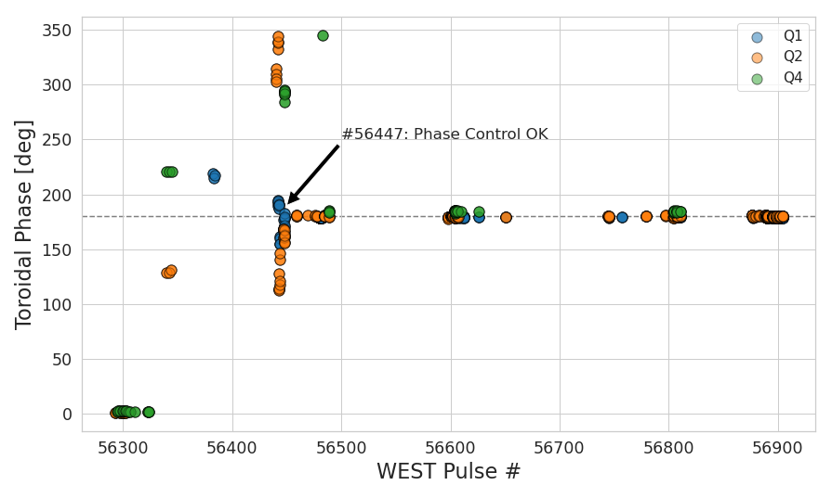
New Toroidal Phase Control (2/2)
Example on a wriggling plasma
Very good reliability: +/- 1°
Phase is slightly disturbed (up to +/- 5°) when multiple antennas are used (crosstalk)
IC Power
Coupling Resistance
LCFS Radal Position
1cm
Commissioning, testing
and bewilderment …
+/- 1cm
Toroidal Phase
+/- 1°

Slide 7
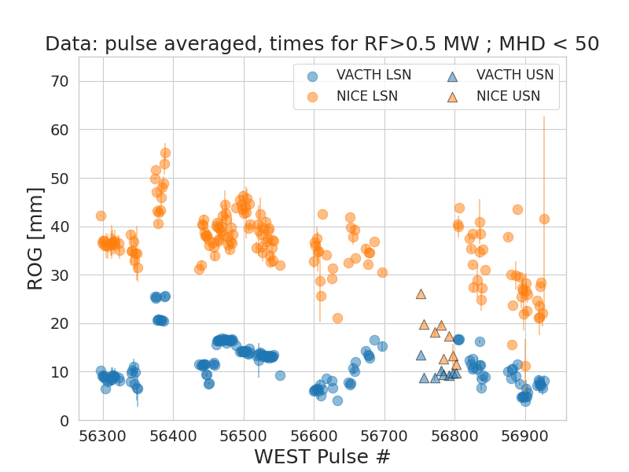
Differences between magnetic reconstructions persist
ROG Estimation is still different between VACTH (real time) and NICE reconstructions
Smaller difference in USN vs LSN
As in C4, coupling is better in USN
→ Main explanation for higher coupling resistance observed in USN plasma
→ So still some margins to improve coupling
NICE
VACTH

Slide 8
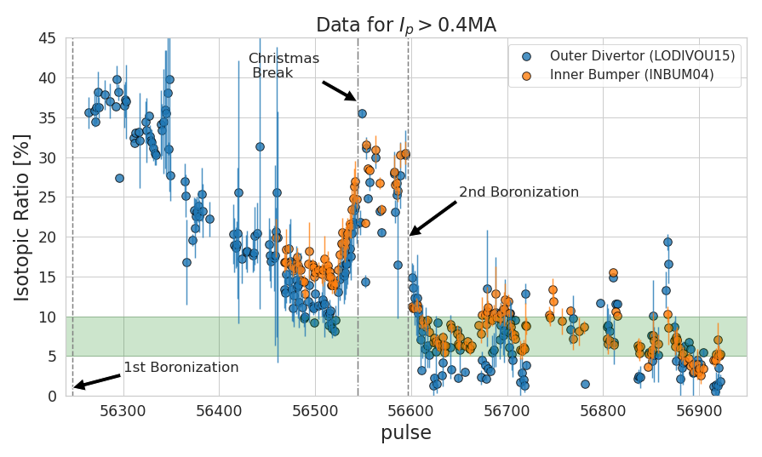
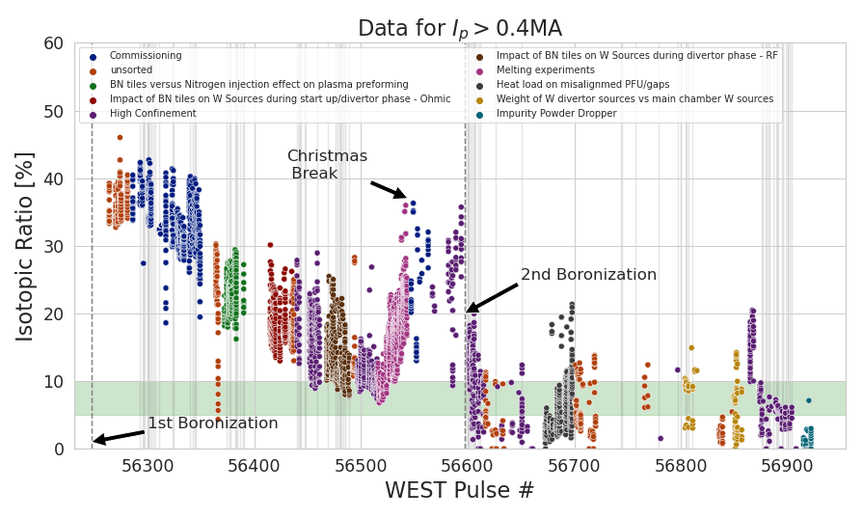
Operational Difficulties in C5 to Control the Isotopic Ratio (1/3) Evolution during the campaign
Isotopic Ratio went from 35% at the beginning of the C5 campaign to finish at ~5%
H outgassing associated to the new BN tiles installed for C5
Evolution depended of the RF power energy injected and boronization

Slide 9
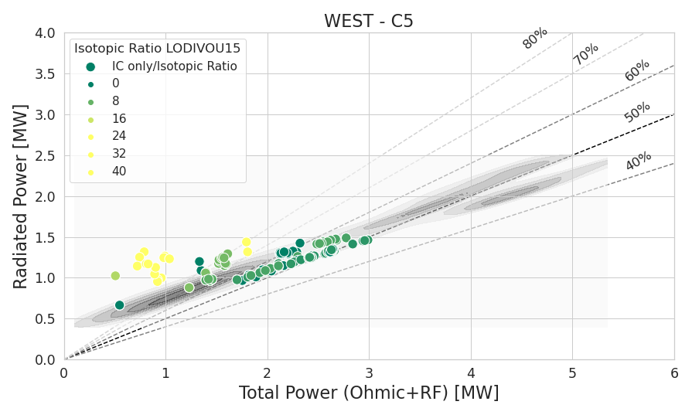
Operational Difficulties in C5 to Control the Isotopic Ratio (2/3) IC operation alone
When >20%, nearly all ICRH power goes into extra radiation.
When in the “normal” range, radiated fraction 50-60%, similar to LH alone
Controlled Isotopic ratio challenge in C6
December
January

Slide 10
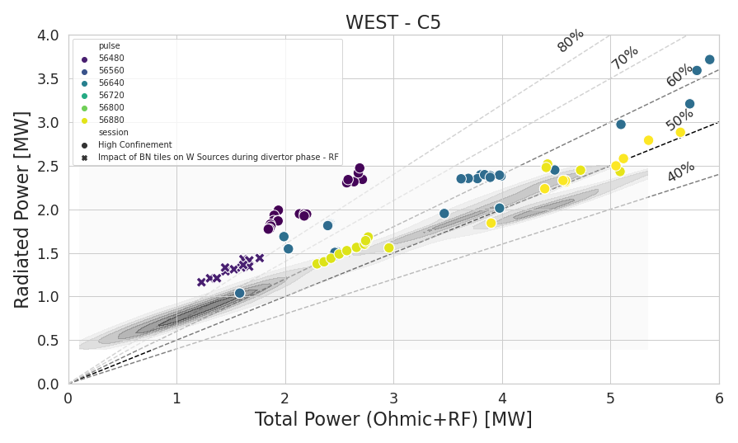
Operational Difficulties in C5 to Control the Isotopic Ratio (3/3) LH+IC combined operation
December vs January operation
Hard to disentangle the effect of the 2nd boronization to the isotopic ratio
In January, radiating power LH+IC follows same trend than LH or IC alone (50%) (excluding during MHD)
Comparing to C4, introduction of BN tiles didn’t change the radiated power during RF operation
No increase of P_{rad} as some could have expected
Boron limiters can be seriously envisaged
New antenna limiters are under study (for C7 or C8)
December
January

Slide 11
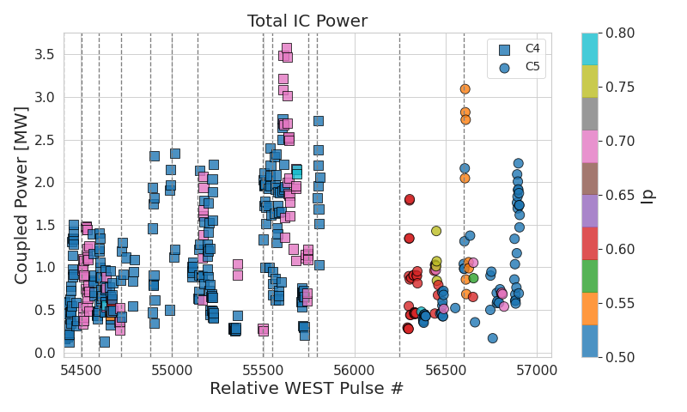
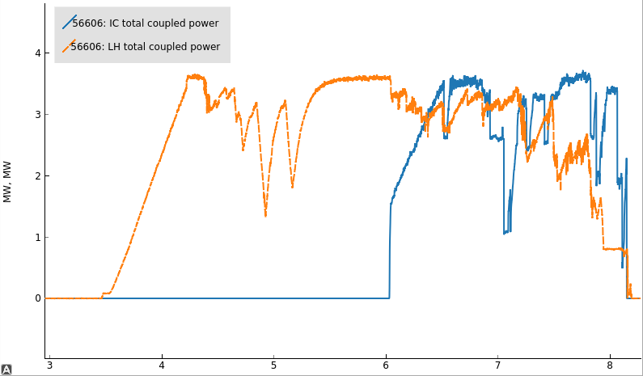
WEST C5 Statistics – Average Coupled Power C4 vs C5
The maximum coupled power achieved in C5 was not higher than in Q4
But somewhat a faster ramp-up
Highest power achieved at lower I_{p} than in C4
Despite coupling generally most difficult at such I_{p}
for P_{IC} ~ P_{LH} ~3 MW both
(average on pulse)
n_{l}~5.3
ROG 2cm vs 4cm
No LH vs ~same LH
C5 RF Commissioning
C4
C5

Slide 12
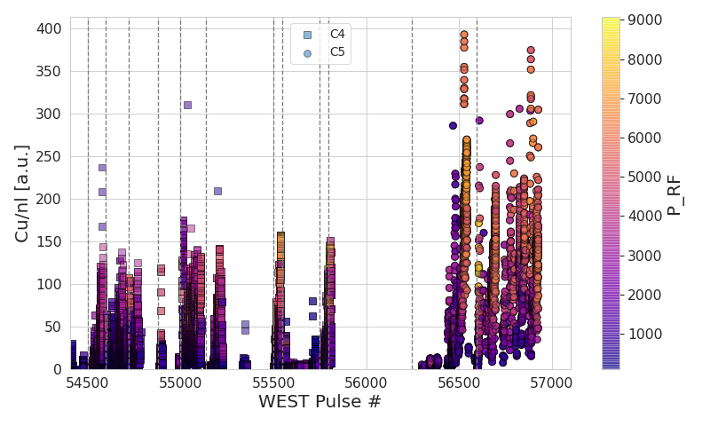
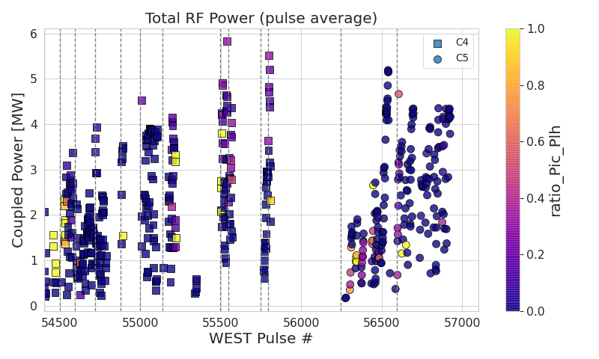
…C5 Campaign was marked by a higher Copper impurity level
Despite similar range of RF Power, higher Cu level
Directly affects operational limits (interlocks for LH Power)
Origin is still unknown
C4
C5

Slide 13
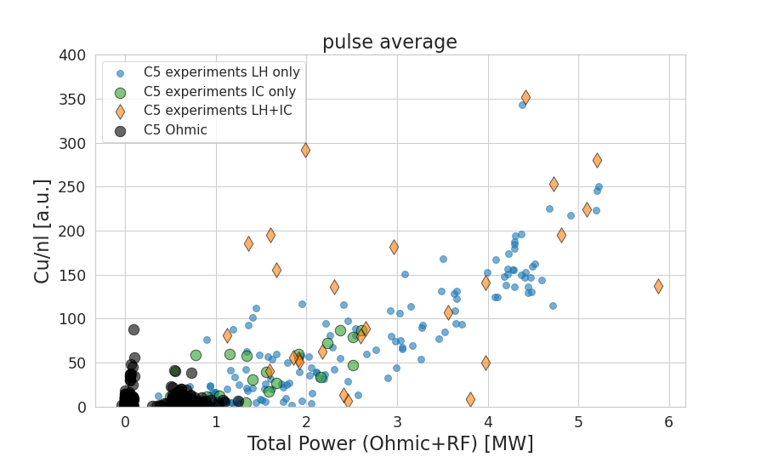
The Control Room Question #1: Does ICRH trigger more Cu impurity than LH?
when RF systems operated independently, Copper impurity level is mainly driven by total power
No specific effect of ICRH in the release of Cu impurity
Much higher values during LH+IC (except after boronization)
Cu impurity increases dramatically due to some interaction btw LH & IC (independently of the order LH/IC)
Physical mechanisms unclear yet, to be investigated in C6
Lower points: Just After boro

Slide 14
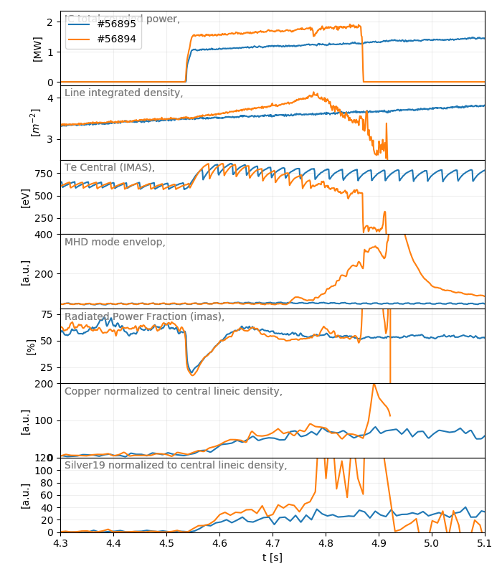
The Control Room Question #2: Does Q4 generates more impurities than other antennas?
Rather unclear (to me) if intrinsic to Q4 or ext. consequence
Egg or chicken problem
In this example #56895 (Q1+Q2) vs #56894 (Q1+Q2+Q4)
180° Phasing OK, Voltage Magnitudes & Balancing OK
n_{e} rises faster on 56895 (Outgassing of what?) -> T_{e} drops faster,
MHD is triggered (->R_{ext} oscillates) and silver impurity levels rise
Note that f_{rad} is similar (~60%) before and during IC
Transport effect or additional sources effect?
Cu Impurity level similar before MHD (Ag slightly higher due to +0.5MW
Remarks
Limited time allowed for power ramp-up on Q4 vs Q1 & Q2…
Outgassing due conditioning effect?
Proper dedicated time required to ramp-up antennas for a given scenario…
Real-Time Silver Impurity Signal can be used as an IC power interlock. To be tested in C6.
P_{IC}
MHD
n_{l}
T_{e}
MHD
f_{rad}
Cu₁₉
Ag₁₉

Slide 15






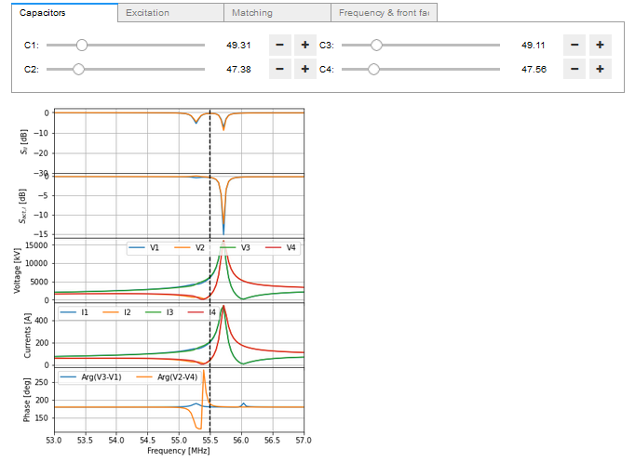
RF Modelling: Towards a Digital Twin Representation of the Antennas
WEST ICRH Antenna Model
Validated against antenna measurements
Opens-source, used by collaborators (PPPL) for coupling modelling (Petra-M)
First results show good relative results between experiments & modelling
Work on-going to match experimental values from plasma profiles & equilibrium
Antenna Model + Jupyter Notebook + Voilà → GUI for IC Operator
Goal: Help IC Operators in Control Room
Future work: post pulse measurement interpretations & next pulse predictions

Slide 16

Work performed under the hood
Several hardware problems have been fixed during the campaign
Often not visible, despite being critical, here is a non-exhaustive list:
Unbalanced power between left and right side of Q1:
Defect in one of the RF oscillator. To be replaced for C6.
Up to 9mm Radial Misalignment between left and right sides of Q2
Due to an incorrect setup of the pressure between hydraulic cylinder. Fixed 18/01.
Various repairs at plant:
Anode Current Sensor Voltage Power Supply Repaired
Leaking Pressurized Air Network Refurbished
Low Power Stage Anode Capacitor replaced (no more spare part)
…

Slide 17
Post C5 Visual Inspections

Slide 18
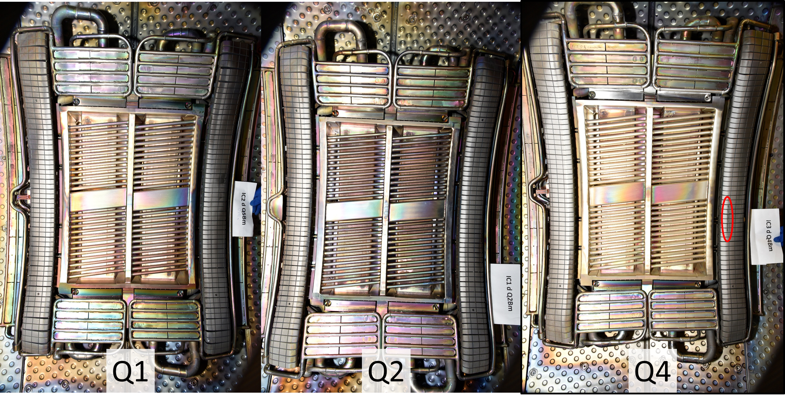
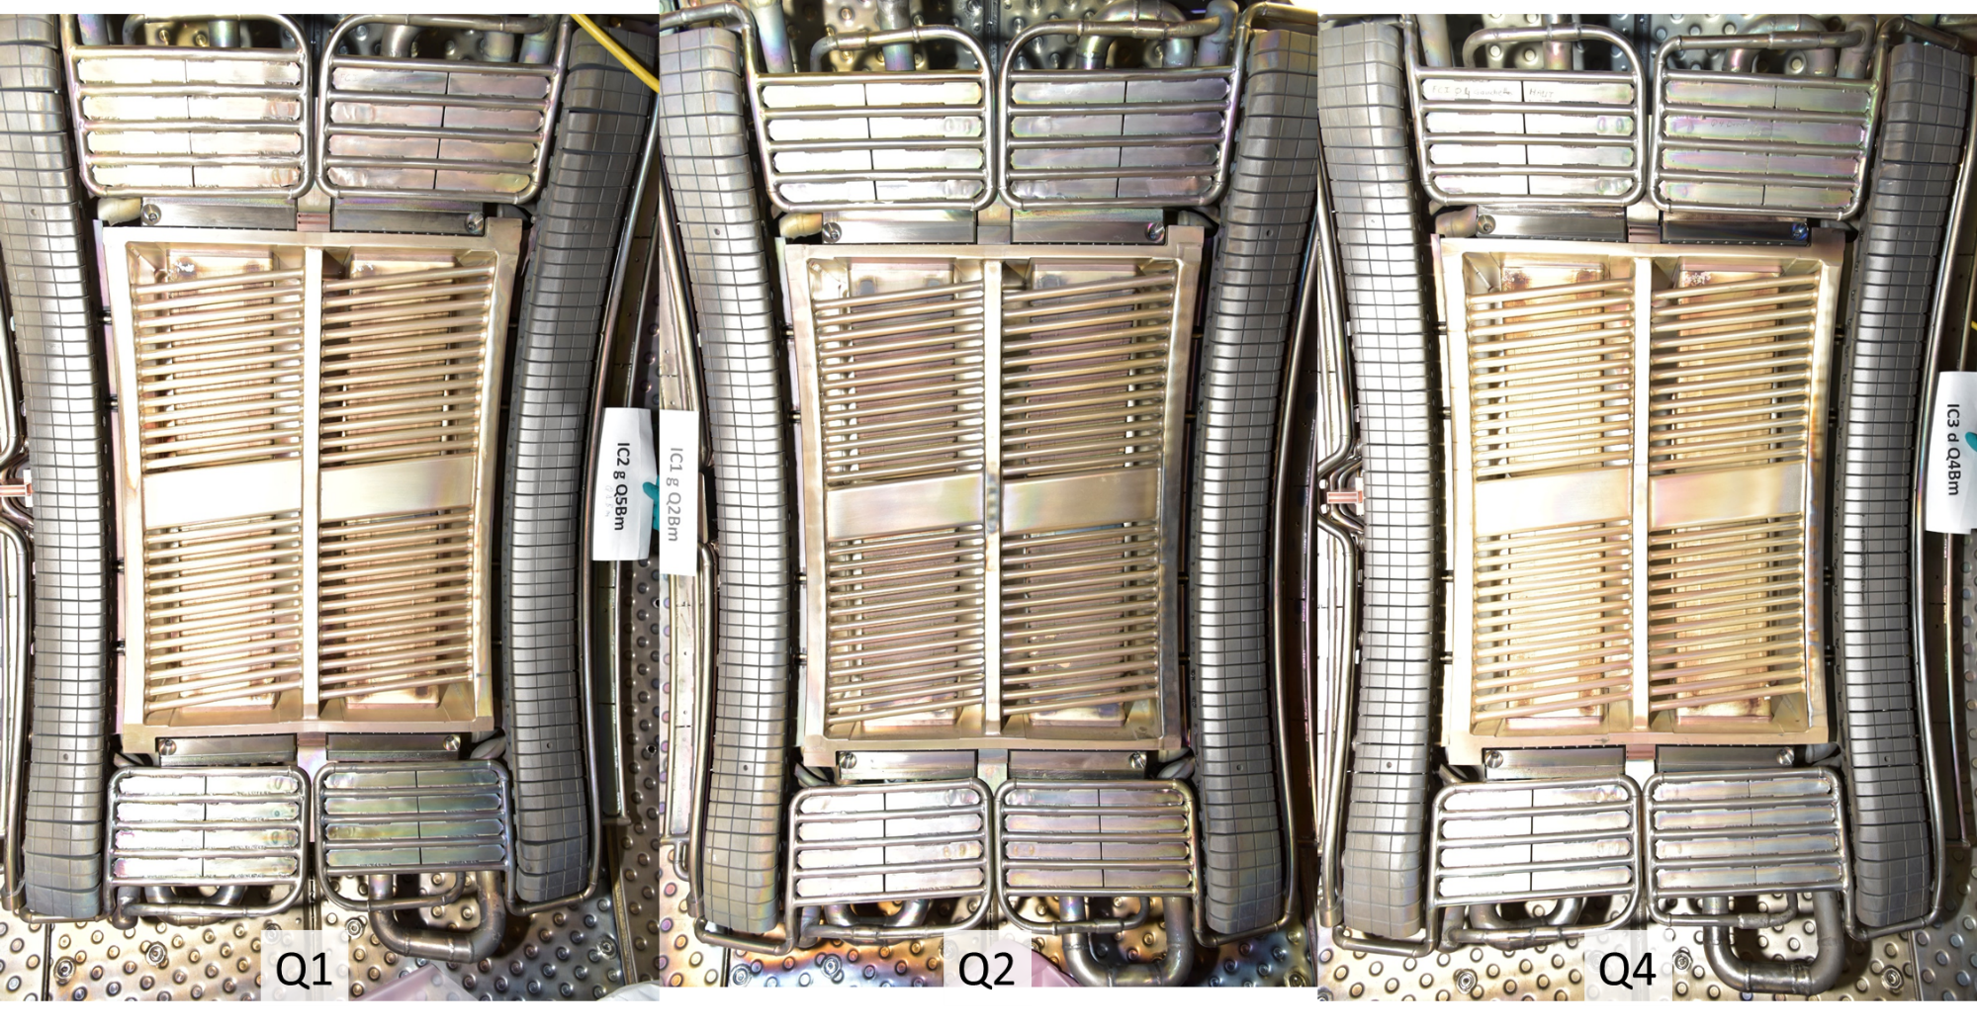
ICRH Antennas after C5
Antennas Faraday Screen “copperized”
Silver coated now looks more orange than white.
Does IC power remobilize copper dusts and non-adherent coatings?

Slide 19
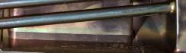
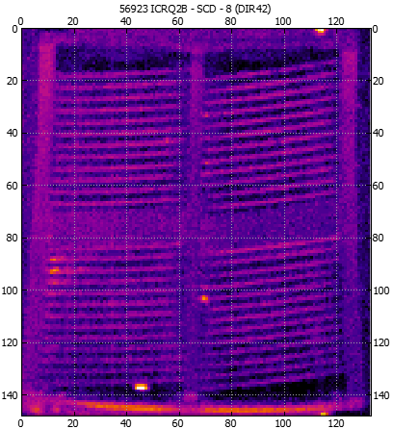
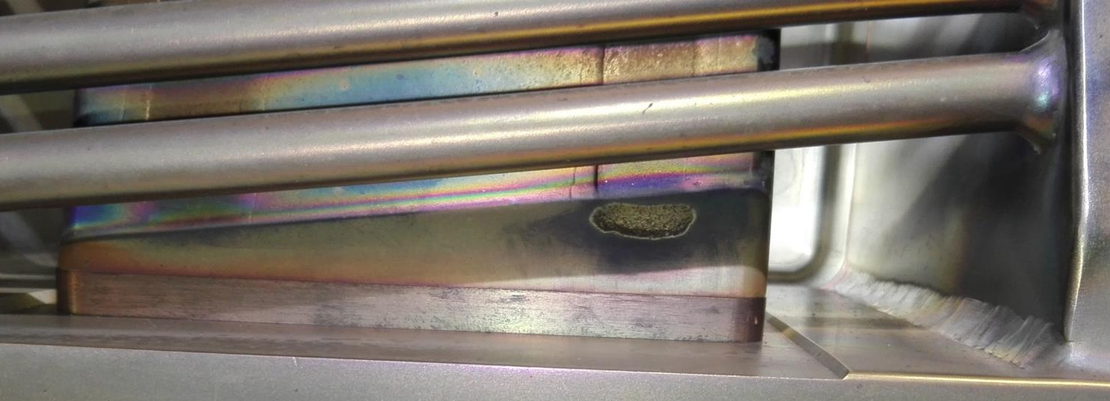
Hot Spot on Q2 due to a local change in the Q2 strap
Before C5
Hot spot appear on Q2 antenna during C5 campaign RF restart
Inspection reveal real surface feature
FS bars clean
→Investigations on-going…
After C5

Slide 20
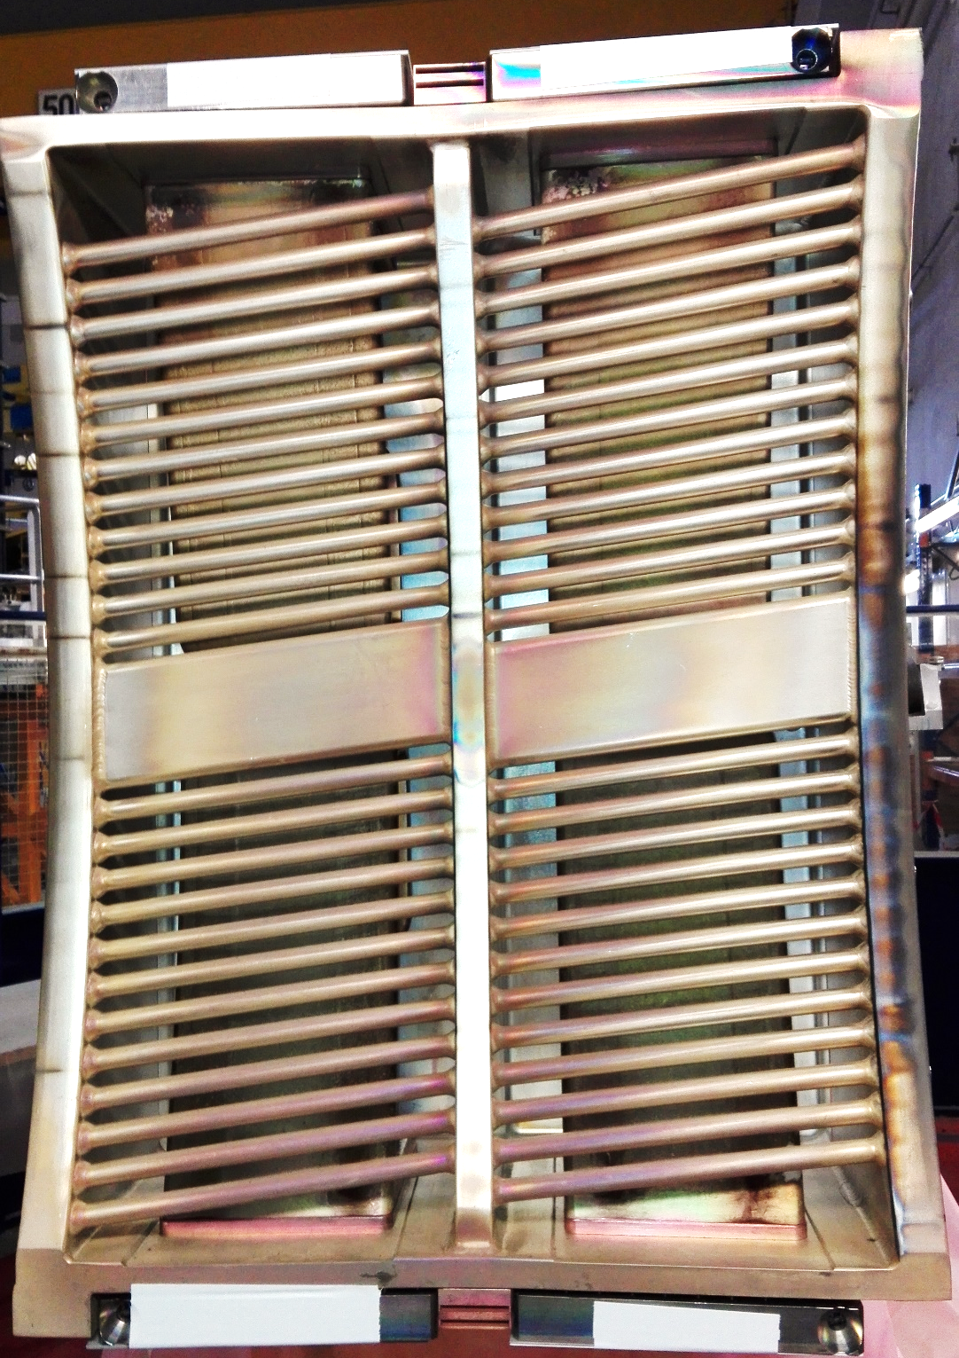
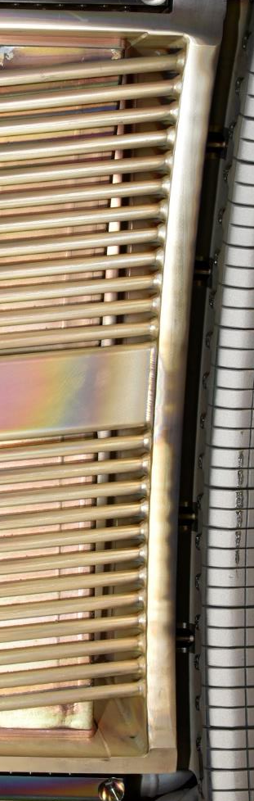
Q4
Right side of the Q4 overheated during C5
But no new damage on right lateral limiter (tbc)
Due to plasma start-up at the beginning of C5? Not inspected with AIA during C5, no clue…
Explanation for the silver production associated with Q4?
Q4 removed from the machine during S5
Planned before & required to change divertor elements
Investigations on-going…
Before C5
After C5

Slide 21
Perspectives for S5 shutdown and C6

Slide 22
Remaining Work
Work during S5 shutdown
Validate inner conductors water cooling setup (allows >30s)
Setup compatibility with WEST baking mode
Change voltage probe cables of Q4 antenna + change RF cables to CODAC
Repair Q2 strap? Clean Q4 Faraday Screen?
…
Planned work for C6
Implement VUV Silver signals as security (like copper for LH)
Validate the automatic matching with the new capacitor motorization system (not enough time in C5)
Develop local gas puffing scenarios with the full pumping capability
Plasma start-up assisted with ICRH (WP-TE experiment)
Relative Antenna Phasing Experiment (WP-TE experiment)

Slide 23
Preliminary Conclusions for C5 Campaign
Antennas Phase Control Validated
Good Reliability of +/- 1°
Some work remain for automatic matching with the new capacitor motorization system
Operational Difficulties in C5 to Control the Isotopic Ratio
Real issue: varied from 40% to 0%...
Lead to extra radiated power and probably other problems -> to be avoided
Issues with copper?
Plasma facing components, especially antennas, copper coated
Separated IC or LH operation is OK, but combined operation leads to additional difficulties
Work is on going to understand how to improve the situation
PRELIMINARY

Slide 24
Thank you for your attention

Slide 25
Spare slides
Pas directement lié au sujet

Slide 26
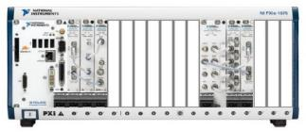
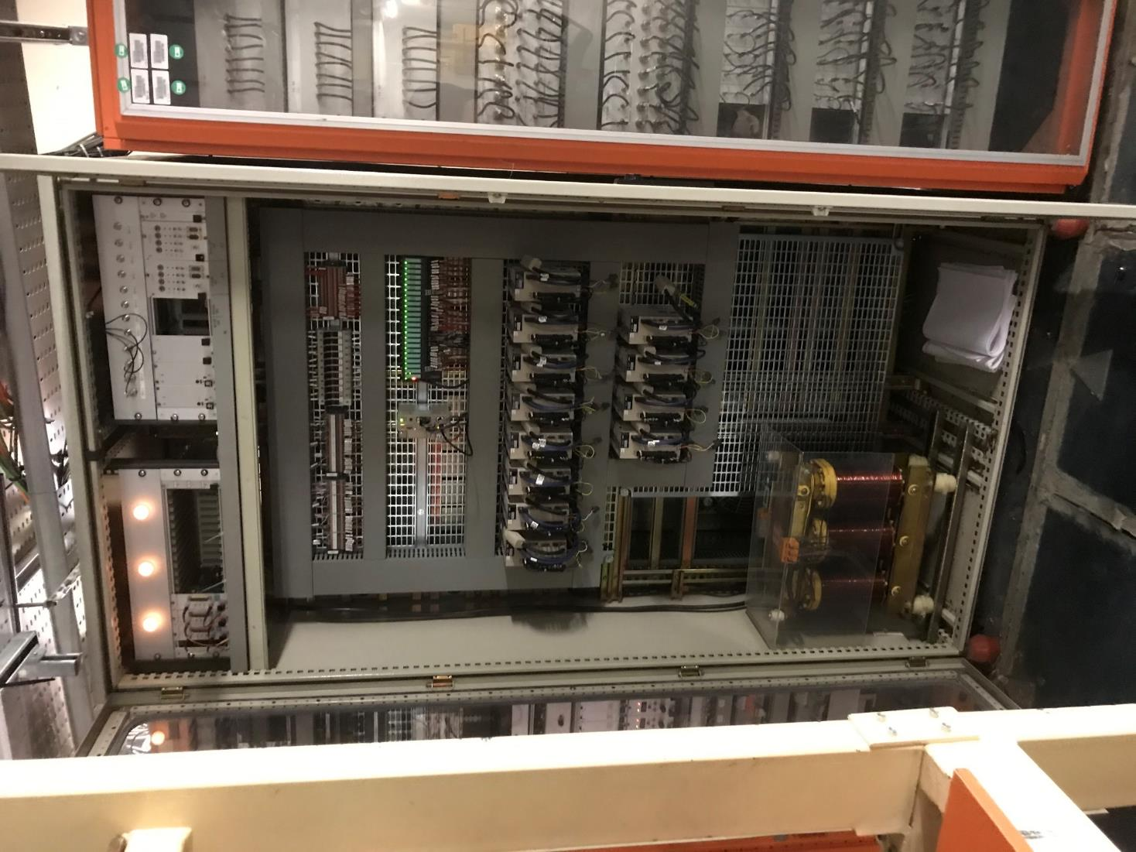
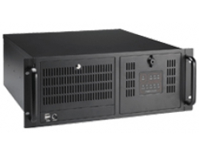
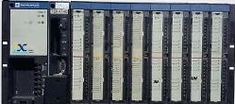
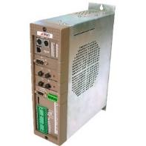
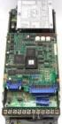
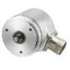
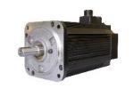
New Capacitor Motorization System
CODAC
API
RS232
STOR / ETOR
Velocity requests (+/- 10v)
RF presence (True/False)
Controller
servopacks
Capacitor coders
Motor command
Motor coders
3 controllers →1 single controller
12 new motors
12 new servopacks

Slide 27
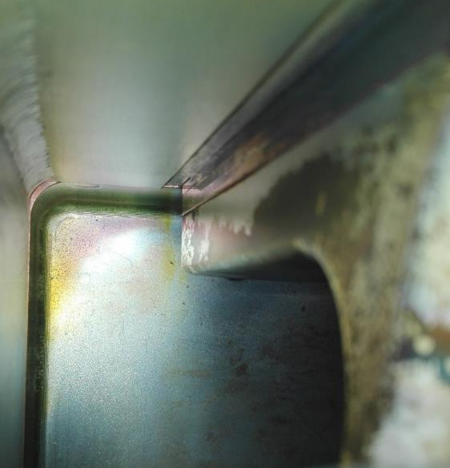
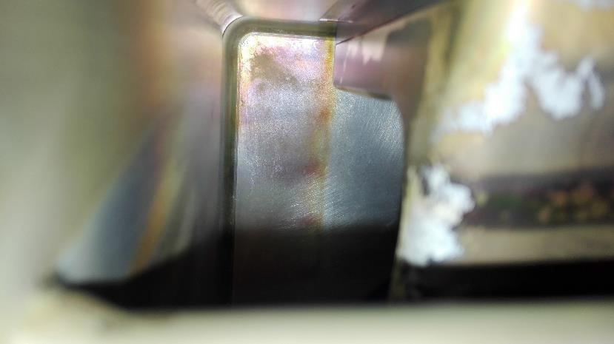
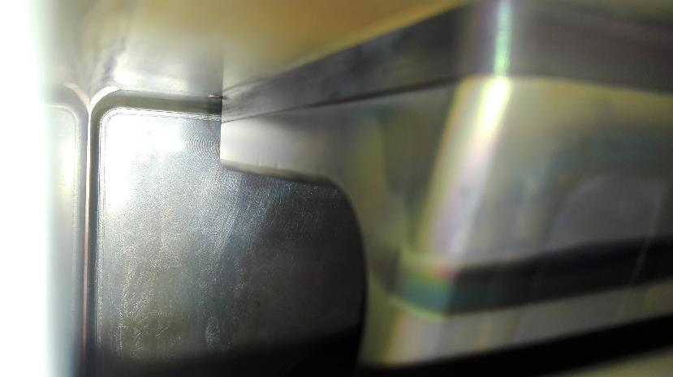
Inside Antenna Boxes
Much more copper (?) deposition inside Q1 and Q4 than Q2
Hypothesis: Q2 is less connected to LH launchers than Q1 and Q4?
Q1
Q2
Q4

Slide 28
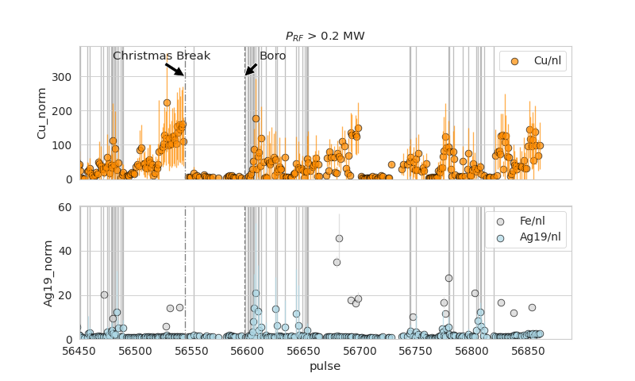
Evolution of Copper, Iron and Silver Impurity
Averaged during RF operations
Vertical lines: Pulse with ICRH power

Slide 29
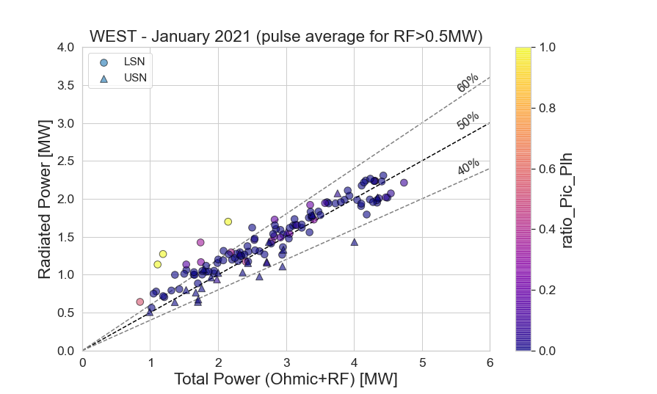
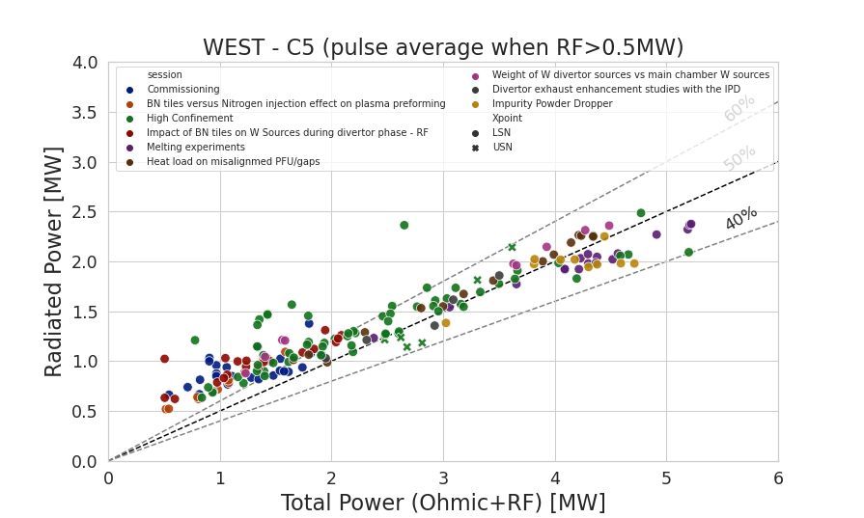
Radiated Power
Between 40 to 60%
But
56625
56601
56626
56651

Slide 30
Despite similar range of RF power…
C4
C5

Slide 31
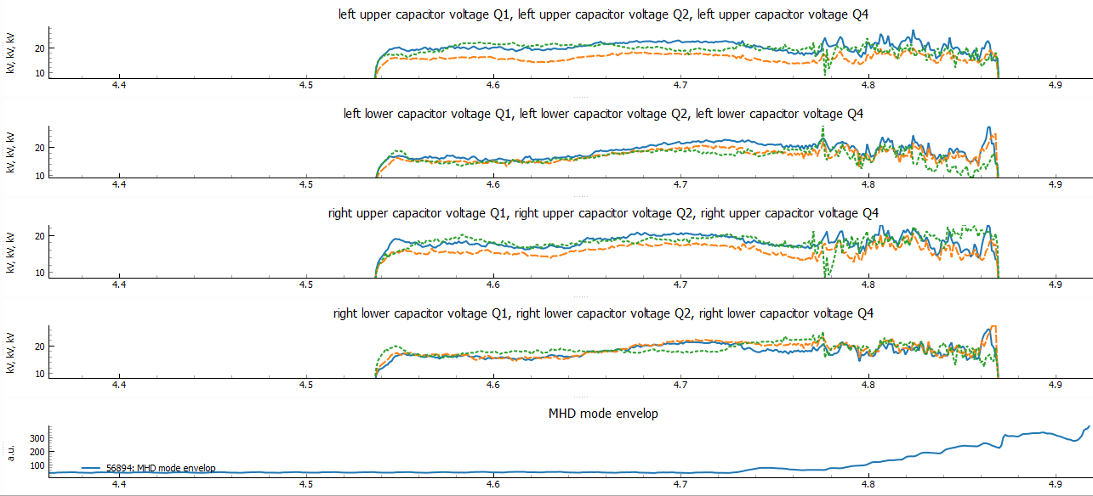
56984
Despite similar voltages, Q4 antenna generated more impurity that Q1 and Q2

Slide 32
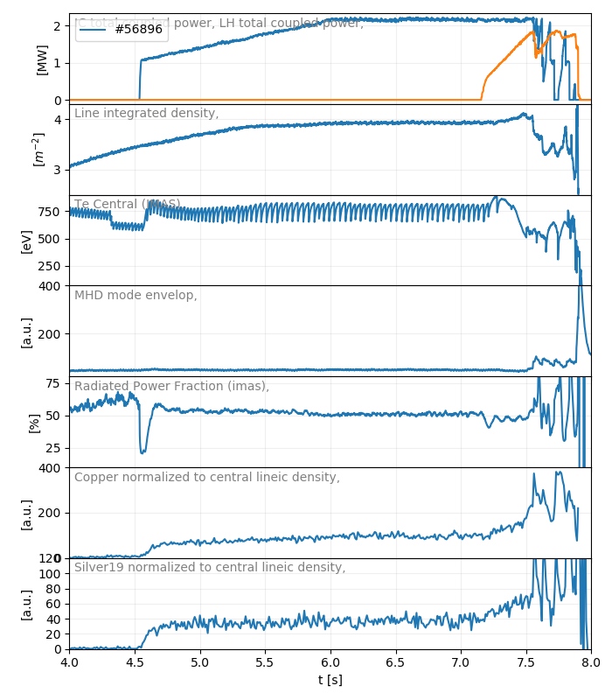
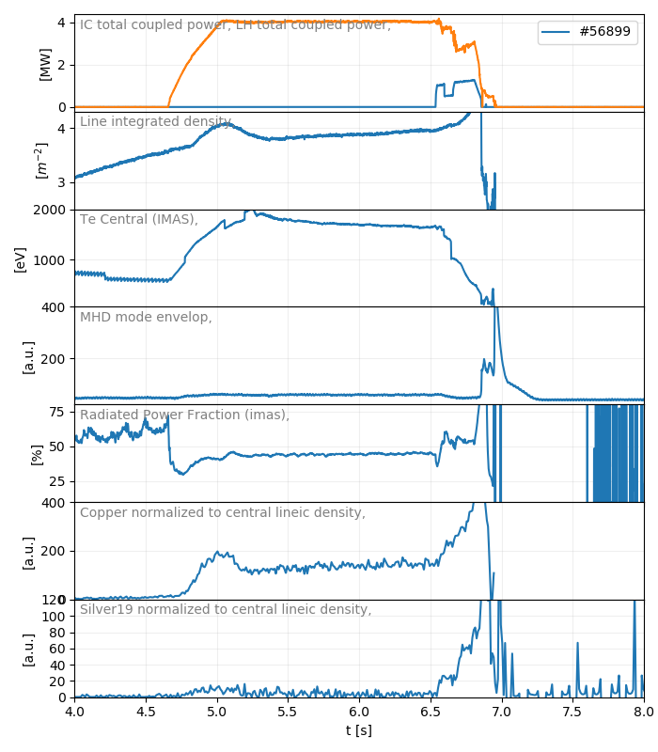
The Control Room Dilemma: How to combine IC & LH properly?
Examples with the last high confinement session (nl~4)
56896: IC 1st, then LH
56899: LH 1st, then IC
150/4MW=
100/2MW=

